Slide 1
Short Course in Linguistics
Identity through language

Slide 2
Topics
Phonetics and Phonology
Morphology
Syntax
Language Change
Identity

Slide 3
Some reminders from the first week...
Languages are extremely diverse
Over 7000 languages spoken in the world
No-one ever has complete mastery of the languages they speak
Most people in the world speak more than one language
43% bilingual
13% trilingual
3% quadrilingual
1% are polyglots.

Slide 4
And most importantly..
Language is a complex, mutually agreed system for linking form to meaning
We use language to relay information about events and social relationships

Slide 5

Identity and Language – an exercise

Slide 6
How did you recognise them?
The sound of their voice (phonetics)?
The words they were using (lexicon)?
The topics they were talking about (context)?
The way they spoke (pragmatics)?

Slide 7
In actual fact...
You used all of those things, more than likely without realising it
Within a language group, people are able to recognise people from their own social, ethnic and geographic area based on language usage
We use several terms to describe this variation in language usage
Sociolect
Ethnolect
Dialect
Idiolect

Slide 8
Identifying individuals
In the first week we spoke a lot about phonetics and what factors affect the sounds we make
There are physical factors
The length of a person’s vocal tract
The shape of a person’s mouth and teeth
Any impairment to the vocal tract
Age

Slide 9
Identifying individuals
We also spoke about the way we measure the characteristics of speech
Measure voice at 25 ms intervals with an overlap of 10 ms
Captures all of the information about how a person transitions between sounds
Captures the frequency and variation in the sounds that they use
Captures idiosyncrasies of their speech

Slide 10
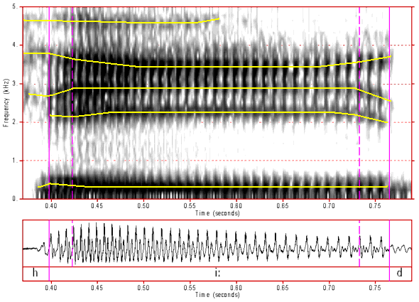
Identifying individuals
Top is a spectrogram (FFT of a waveform)
Bottom is the waveform
This is the word ‘heed’

Slide 11
Identifying individuals
Taking English as an example
Some samples from the IDEA website....
We just heard a large range of accents, but what is an accent?
It’s a manner of pronunciation particular to a person’s location, nation, ethnicity, social status, education or other social factors
But how can we measure it?

Slide 12
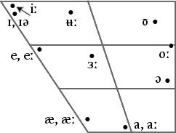
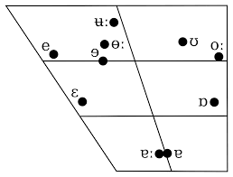
Measuring an accent
Australian English
New Zealand English
Notes:
These are plots of the second two formants, F1 and F2, so we can measure this quite easily
End up being regions and not just points
And they shift over time and with contact with other people
My vowels shift between standard QLD and Standard Australian
Vowels aren’t the only thing the can be used for accent

Slide 13
Identification through phonetics
And the Gileadites took the passages of Jordan before the Ephraimites: and it was so, that when those Ephraimites which were escaped said, Let me go over; that the men of Gilead said unto him,
Art thou an Ephraimite? If he said, Nay;
Then said they unto him, Say now Shibboleth: and he said Sibboleth: for he could not frame to pronounce it right. Then they took him, and slew him at the passages of Jordan: and there fell at that time of the Ephraimites forty and two thousand.
(Judges 12:

Slide 14
Moving up the stack...
Morphology tends to give people away as well
In English, if we use the wrong verb endings, you can tell which socio-economic group people come from
In other languages, different usages of the wrong morphology can mean membership of different groups
But it can also be an indicator of a second language learner

Slide 15
Second Language Acquisition
The age at which you learn a language and your first language impact your use of subsequent languages
Learning grammatical gender is notoriously difficult
Learning verbal aspect is difficult
Learning most verbal morphology is hard (people tend to do better with written than spoken production)

Slide 16
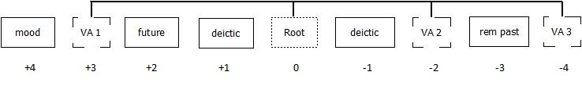
Compare English and Thuntai
English has simple verb formation rules
Verb + tense (‘-ed’, ‘-ing’)
Verb + person (‘-s’)
Thuntai not so much

Slide 17
Compare English and Thuntai
My production of Thuntai verbs is, we’ll call it interesting
I make mistakes with the combination of actors and subjects and with grammatical gender that results in apparently hilarious combinations of people doing things to other people
If you were presented with my written or spoken Thuntai, you’d be able to pick me as a second languages learner

Slide 18
Second Language Acquisition
The pattern of what is hard is dependant on the combination of first and second language
Understanding the morphology of the two languages allows us to predict what the differences might be, but these hypotheses need to be statistically tested
Large body of second language acquisition literature that summarises some of the findings across sets of languages (if you’re interested in anything specific, just come and have a chat)

Slide 19
And up the stack again....
Lexicon
Your choice of words gives away a lot about who you are and what your life story is
Do you have a larger vocabulary than normal?
You’re probably educated
Do you use a lot of nautical words?
You spend time on or around the coast
Do you use a lot of current slang?
You’re probably a teenager

Slide 20
Lexicon
Think about the range of words the only public servants understand
Or IT specialists
Or people who ride mountain bikes
Or the things that only we understand because of our work community
But are there words you use because of your background?

Slide 21
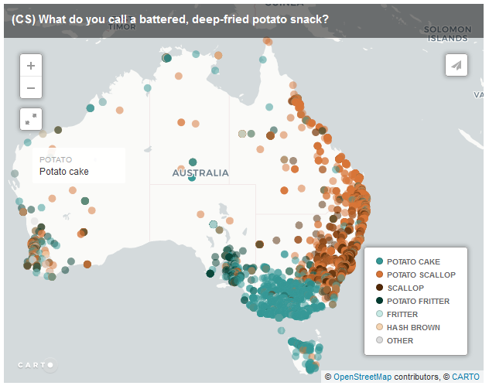
Regional variation in Australia

Slide 22
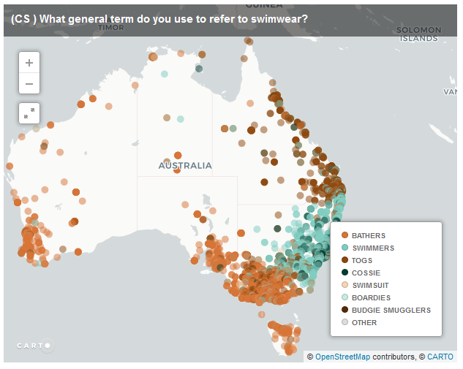
Regional variation in Australia

Slide 23
Tamil speaking caste differences
Gloss | Mudaliyar (non-Brahmin) | Iyengar (Brahmin)
Drinking Water | tanni | tirrto
Water in general | tanni | jalo
Non-potable water | tanni | tanni
Worship | puuse | puuje
food | sooru | saado
worship | puuse | puuje 'worship'// puuse 'punishment for children'
food | sooru/ saado | saado 'food'// sooru 'food' (pejorative)
eat | tinnu/saapdo | saapdo 'eat'// tinnu 'guzzle, etc.' (pejorative)

Slide 24
Norwegian Socioeconomic Differences
Gloss | National standard (Bokmål, B) | Local variety (Ranamål, R)
I | Jeg | Eg
you | Deg | Deg
He | Han | Hanj
She | Hun | Ho
If | Viss | Vess
To, toward | Til | Tell
Who | Hvem | Kem
How | Hvordan | Korsen

Slide 25
Stylistics
Your choice of thinking words
Your choice of interjection (spoken and written)
Your choice of emojis
The way you incorporate non-linguistic devices into your conversations

Slide 26
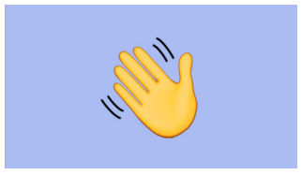
Emojis across cultures
Notes:
Waving hand – friendly goodbye or no longer my friend, well that depends on your cultural perspective

Slide 27

Emojis across cultures
Notes:
Friendly gesture or an indication your partner has cheated on you (some South American Nations and some Mediterranean)

Slide 28
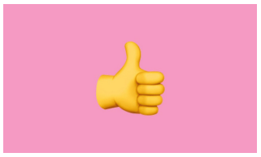
Emojis across cultures
Notes:
Somethings all good or somethings not good? (some middle eastern countries)

Slide 29
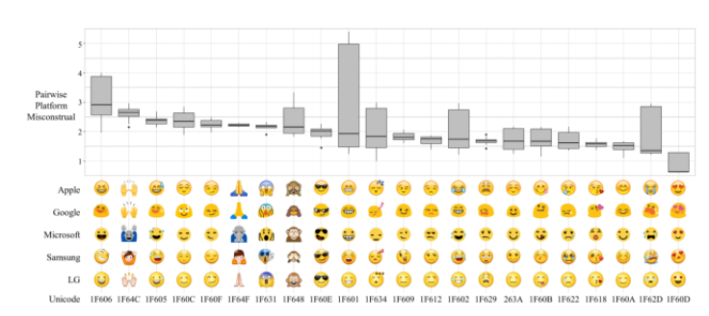
Emoji confusion within cultures

Slide 30
Pragmatics
It’s all well and good to understand how to pronounce a language
Or how to construct words
Or how to read a dictionary
But to be able to use the full range of idiomatic expressions and words in the correct contextual environment is tough
(even for some native speakers – that whole mastery thing)

Slide 31
Pragmatics
Pragmatics extends to how you form your sentences
Where do you typically put your adverbs?
How do you refer to other people?
What abbreviations do you make?
What words do you leave out when you are writing short messages?

Slide 32
Discourse analysis
The illocutionary force behind what you say is also unique to you
Are you normally submissive when you talk to particular people?
Are you more likely to ask questions or give orders?
Do you lead conversations or follow them?
How well do you follow the conversational rules of your language?

Slide 33
Discourse Analysis – some fundamentals
Discourse or conversation analysis is precisely as the name suggests
Some points to remember
Twitter and Facebook posts are not conversations, they are broadcasts
Subsequent comments can be viewed as a conversation
Conversations are not necessarily limited to one exchange between people or one medium, they may cross several
Consider how different conversation with someone you know is compared to someone you do not

Slide 34
Discourse analysis
This type of analysis allows us to infer a range of things about a person
Relationships
Emotional state
Social standing
Conversations are treated as having a several phases
Openings
Content
Closings

Slide 35
Discourse Analysis
There are two other important concepts – pauses and repairs
These give us an indication of what’s going on in the conversation as well
Longer pauses can represent hesitation, more thorough thought, a desire not to respond or that a mistake has been made
If conversations aren’t face to face (telephone or IM) can indicate something else has happened in the background

Slide 36
Discourse Analysis
If pauses go on for too long, things fall apart
Repair is how the people we are talking to try to fix a broken conversation
Repair is employed when people misunderstand something, when they sense something has gone awry (there’s some uncomfortableness), when they realise that something incorrect has been said
Some people are able to repair conversations in better ways than others
Notes:
Tony Abbott clip

Slide 37
Discourse Analysis
Every culture has different rules
American English conversations follow different trajectories to Australian conversations
Even within cultural groups, conversations follow different rules
We can determine a lot from these methods but as of yet, they have not been effectively operationalised for computation

Slide 38
Current forensic uses of linguistic identity
Voice ID
Authorship verification
Genre specific forensic analysis – suicide notes, ransom notes,

